Slide 1
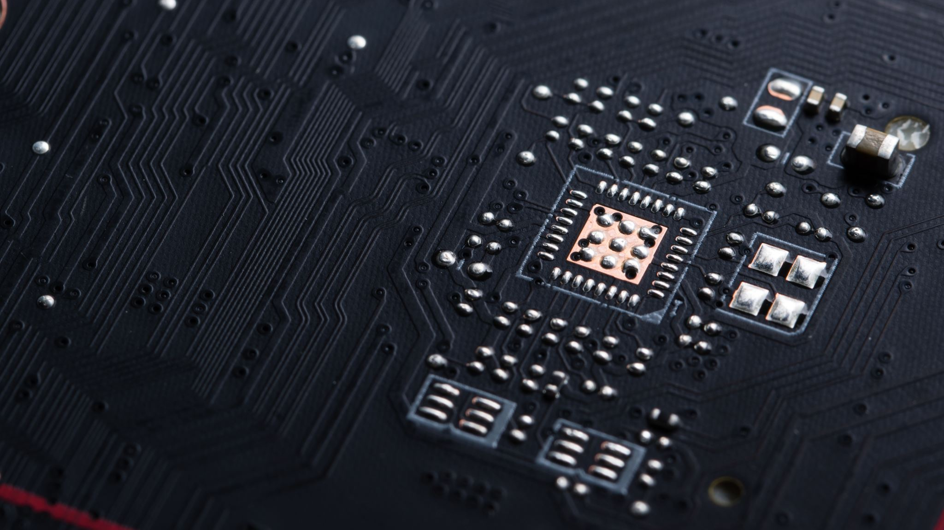
ChIP-Seq
Dr/ Ebrahim ELSamman

Slide 2






Our team
Eman Hamza
Marwa Mahmoud
Aliaa Mohamed
Dina Mahmoud
Marwa Mahmoud
Nada Mohsen
Manar Maher
Habiba Ahmed

Slide 3
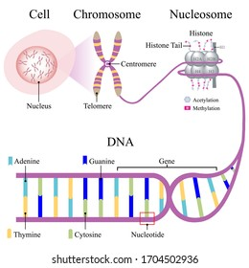
Intro to ChIP_Seq
Inside a cell there is a nucleus and inside each nucleus there are a bunch of chromosomes
Chromosomes are made of chromatin
Chromatin is made of DNA plus histones(a type of protein)
DNA wraps around the histones to “package DNA”, and the packaging can regulate gene transcription
Depending on how they are modified ,histones can activate or repress genes

Slide 4
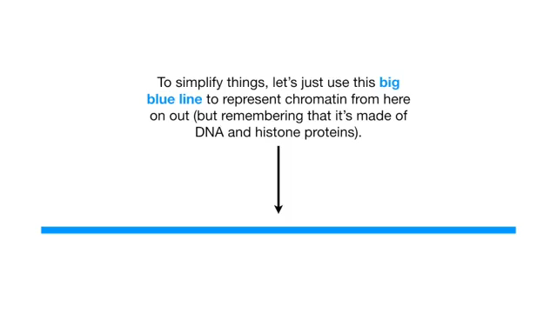

Slide 5
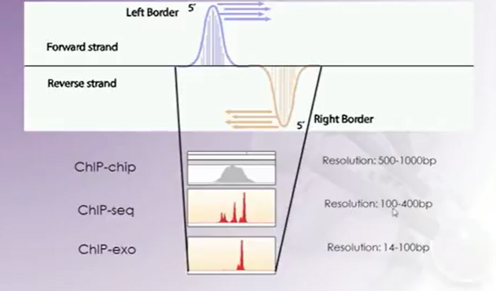
ChIP-Seq
Chromatin immunoprecipitation, or ChIP, is an antibody-based technology used to selectively enrich specific DNA-binding proteins.
The types of Chip :
1-Chip-on-Chip
2-Chip-seq
3-Chip-exo

Slide 6
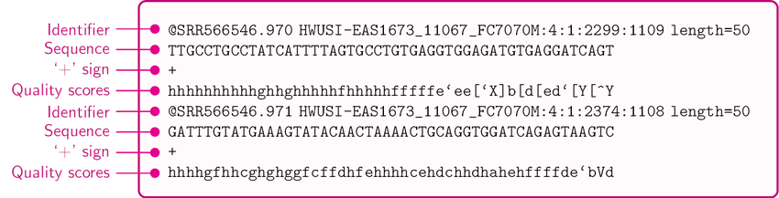
FASTQ Format
Chip-Seq data is as FastQ files.Then, We took them from the Illumina device.
Below is a FASTQ file a chunk of 4 lines describes a read for each read the 4 lines are (1)read name , (2) nucleotide sequence (3)(placeholder),(4) quality value sequence

Slide 7
Introduction
Dataset
Throughout this practical we will try to identify potential transcription factor binding sites of PAX5 in human lymphoblastoid cells.
we will work on datasets ,lymphoblastoid cell line produced from
the blood of a female donor of European ancestry.
Contains 3 parts :
1- transcription factor : PAX5 (regulator of B-cell differentiation)
2- Polymerase II :control file
3- the histone modification : H3K36me3
accession number
GM12878
link
https://www.ncbi.nlm.nih.gov/gene/6612863

Slide 8
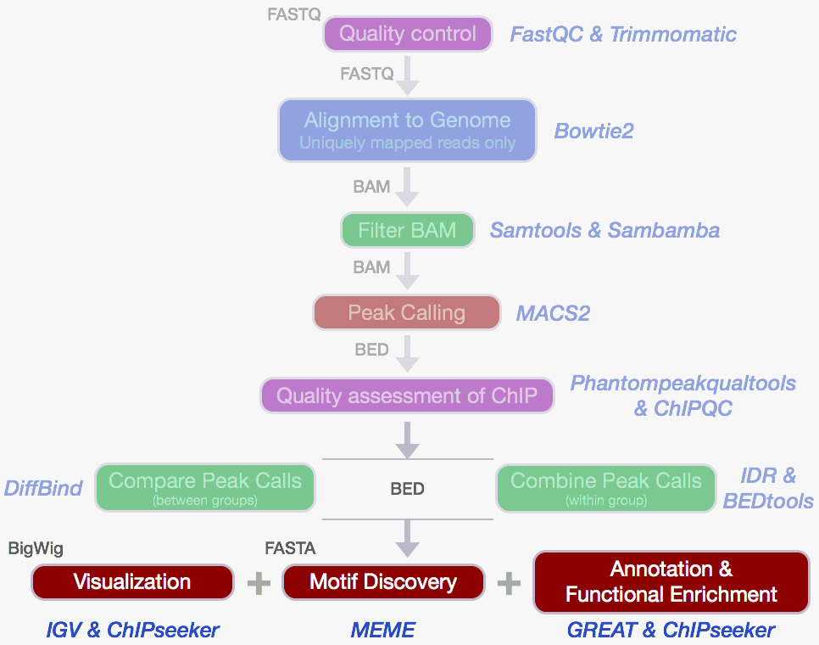
Steps

Slide 9
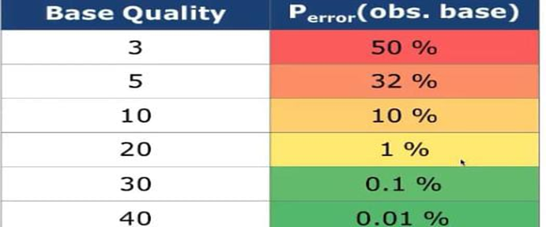
1- Quality Control
We use FastQC to Quality control to get quality score
What is a base quality score? Phred quality scores are estimates of the probability a base call is incorrect

Slide 10
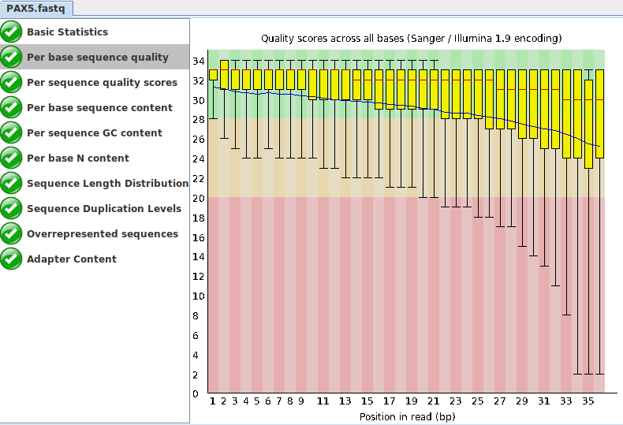
A.Best Quality
We use PAX5.fastq ,because it's best compared to the other.

Slide 11
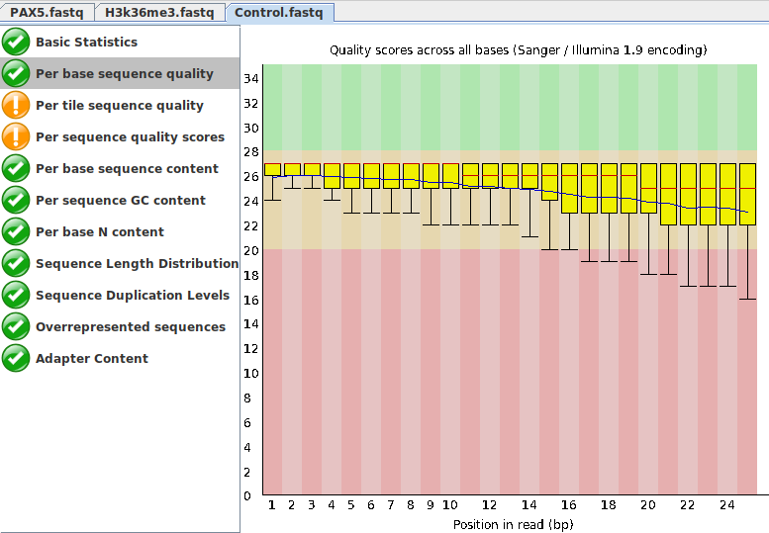
B.Normal Quality

Slide 12
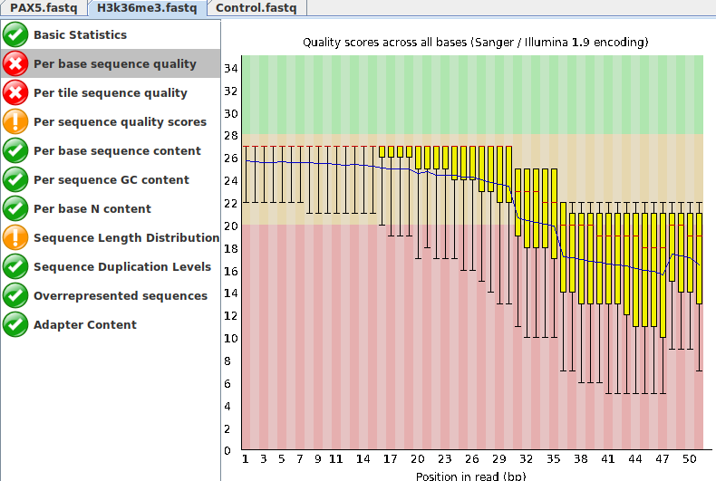
C.BadQuality

Slide 13
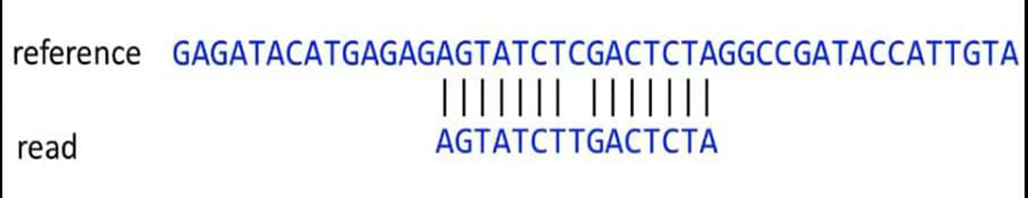
Reference–based analysis : We want to discover genetic variation by comparing reads to a reference genome To do this we need to figure out where the read best matches the reference this is the mapping problem

Slide 14
Sequence alignment /map format :
1-file format for storing read mappings
2-SAM is the human readable text format
3-BAM is the binary format that is efficient to store
4- we will look at command line tools to convert between these format

Slide 15
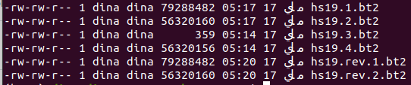
2-Alignment to genome
We use Bowtie2 to Aligning the PAX5 sample to the genome (hs19)
Result
But I can not read it !!

Slide 16
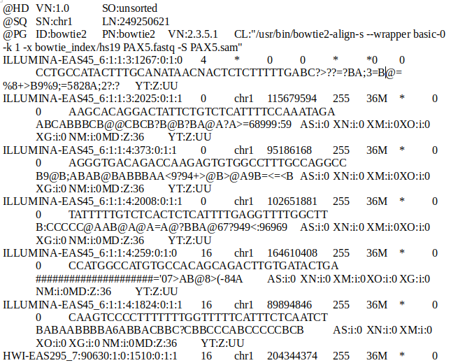
3-Manipulating SAM output
We used Bowtie2 to convert bt2 files to SAM files .
Then , we used samtools to convert SAM files to BAM file .

Slide 17
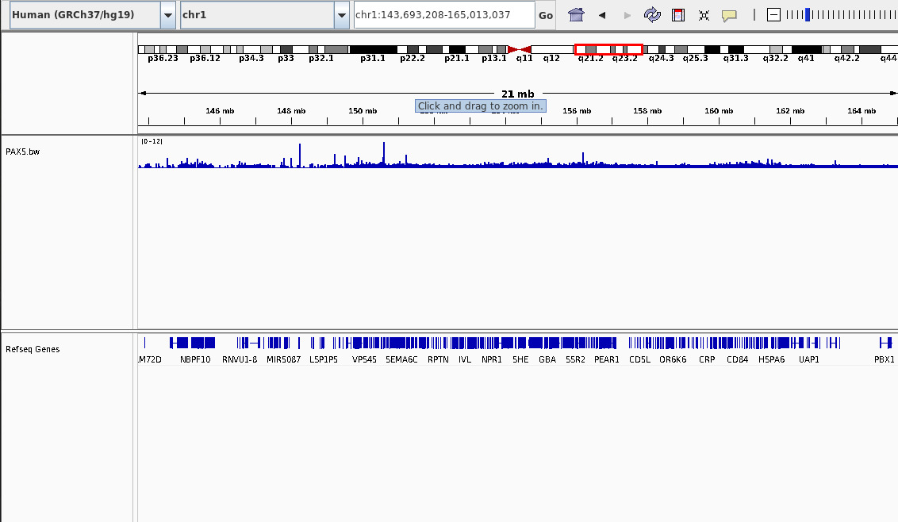
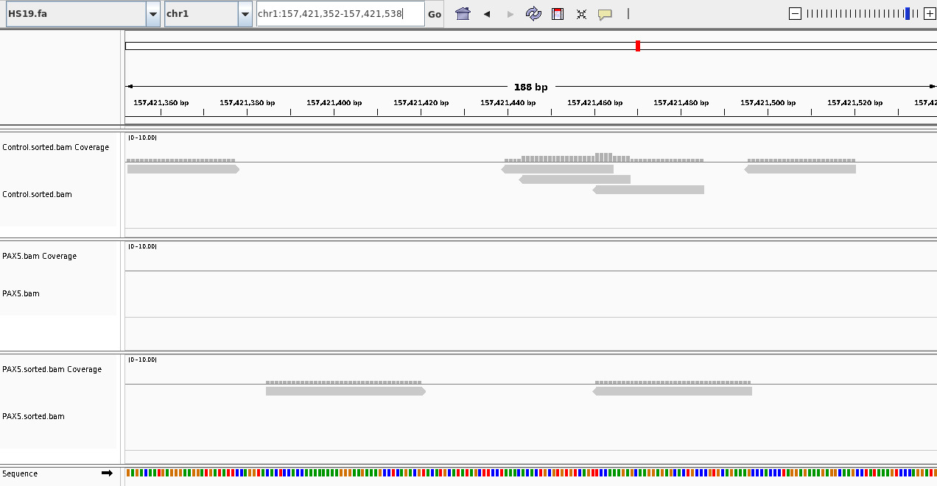
Calling Peaks
An interval peak is a genomic region where the protein of interest is bound, there are two types:
1-Narrow Localization 2-Broad Localization
Software tools used for peak calling: IGV
We uploaded bigwig file or BAM file and reference on IGV .

Slide 18
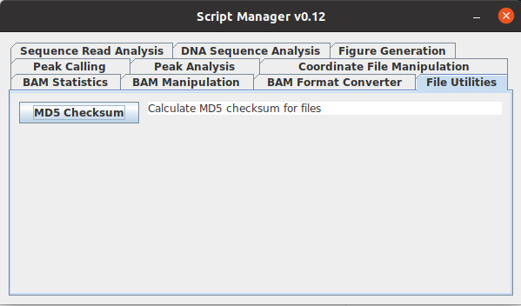
4-script manager
We used a software mongering index to manage the index, we sorted BAM and Put it on the index .After, we convert the BAM file to BED In the end, we make the Graph like plot.

Slide 19
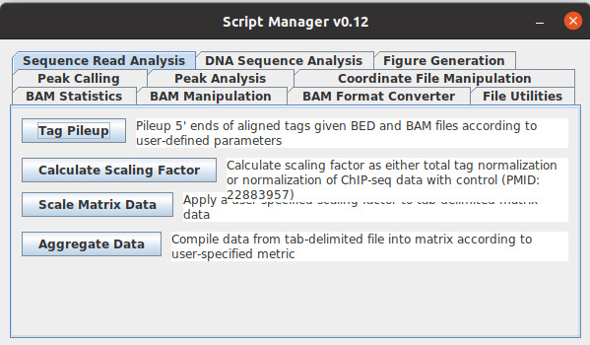
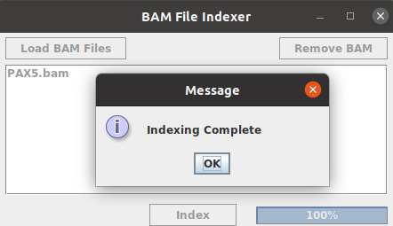
index files
Generate BAI index files for each BAM file of interest
The BAI index file allows for rapid access of the sorted and aligned sequence reads (BAM file).

Slide 20
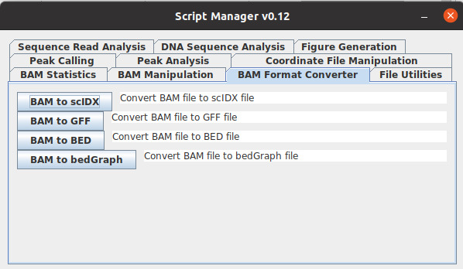
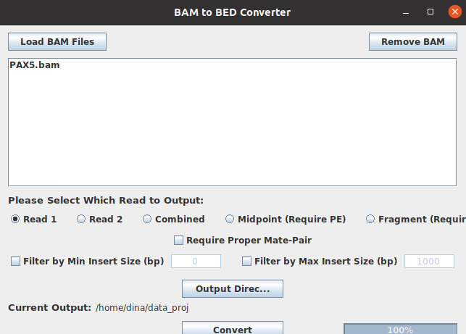
BAM format Converter to BED file

Slide 21
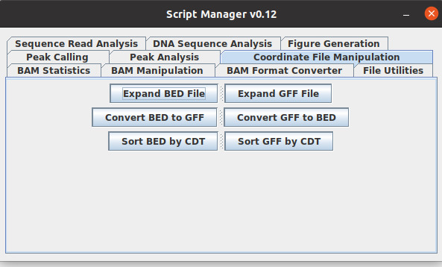
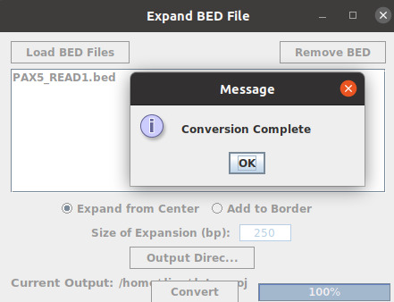
Resize the PAX5 motif-aligned BED file

Slide 22
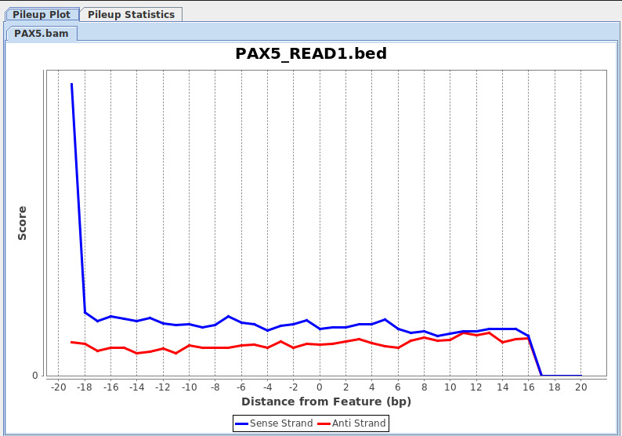
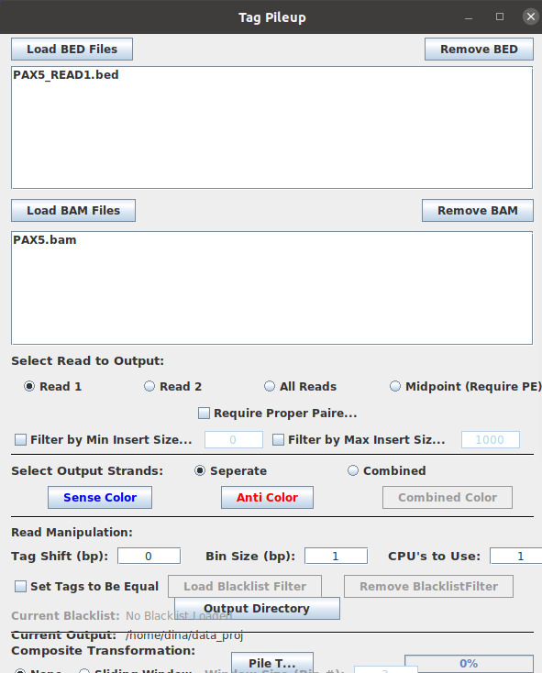
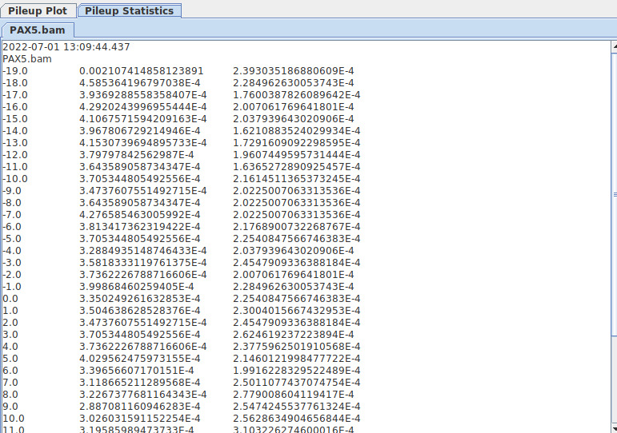
Generate the tag pileup plot for BED file

Slide 23
Meta data
Link article : https://www.cell.com/molecular-cell/fulltext/S1097-2765(19)30798-1
The accession numbers: in this paper are NCBI GEO: GSE120162
Organism: Homo sapiens
Submission date: Sep 19, 2018
Last update date: Dec 04, 2019
Status: Public on Nov 21, 2019
Title: TFIIIC binding to Alu elements controls gene expression via chromatin looping and histone acetylation

Slide 24
Summary
we report regulatory mechanisms unveiling a central role of Alu elements (AEs) and RNA polymerase III transcription factor C (TFIIIC) in structurally and functionally modulating the genome via chromatin looping and histone acetylation.
TFIIIC associates with promoters of N-MYC target genes, facilitates the recruitment of the Cohesin complex subunit RAD21, and is required for RNA polymerase II (Pol II) escape and pause.
we use serum starvation (SS) to unveil a reversible mechanism by which AEs close to cell-cycle genes and marked by the transcription factor Activity-Dependent Neuroprotective Protein (ADNP) recruit TFIIIC to acetylate Histone 3 lysine-18 (H3K18ac).
in human, These changes ensure basal transcription of cell cycle genes and are critical for their re-activation upon serum re-exposure. Our study reveals how direct manipulation of the epigenetic state of AEs by a general transcription factor regulates 3D genome folding and expression.
Notes:
To minimize false positives calling, several input libraries were sequenced to reach saturation with a coverage of 4 reads/bp for the human genome for each condition. The T47D ChIPs for TFIIIC, BDP1, RPC39, and H3K18ac were done in two separate biological repeats and pulled together.

Slide 25
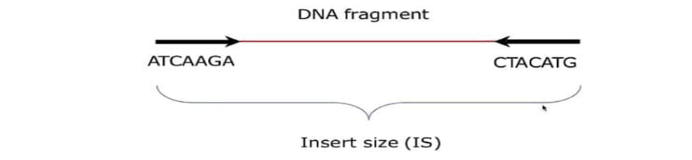
Paired –end reads : Illumina sequencers can generate “paired-end” reads that resolve ambiguous mappings

Slide 26
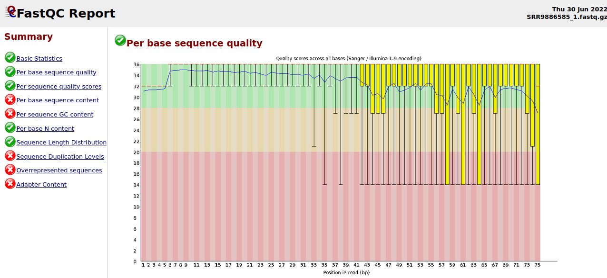
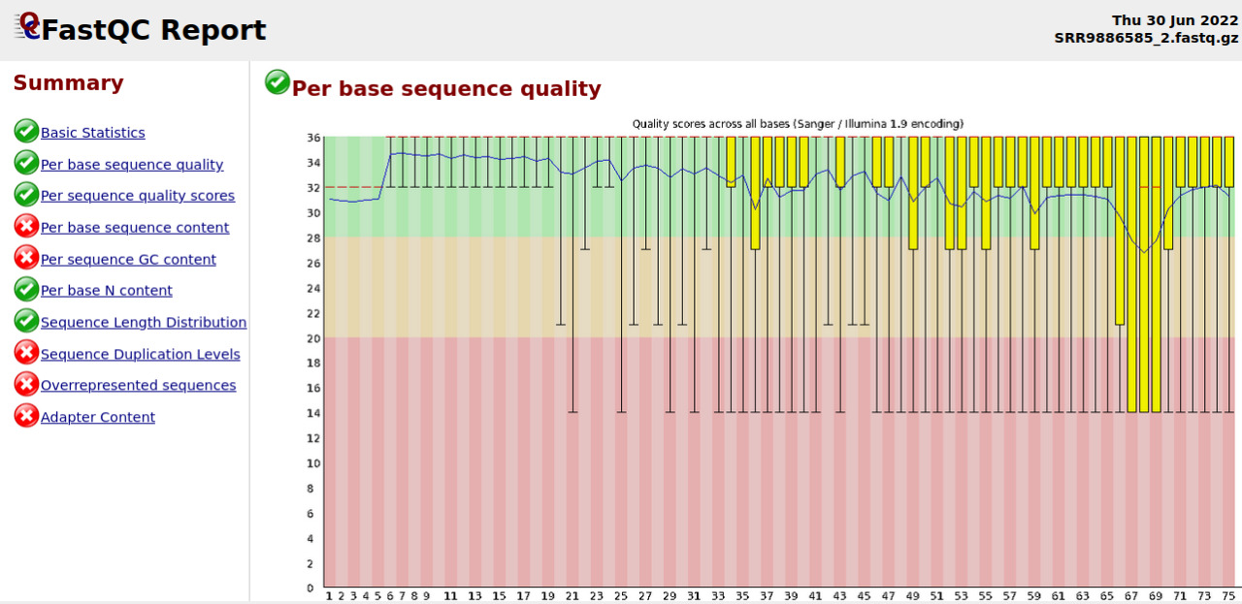
Quality control
FastQC for forward and reverse for SRR9886585.Fastq.gz

Slide 27
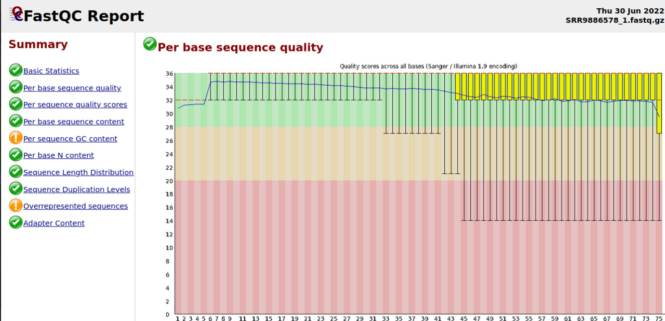
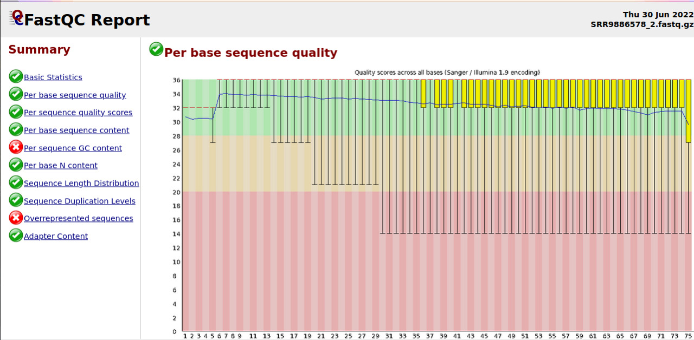
FastQC for forward and reverse for SRR9886578.Fastq.gz

Slide 28
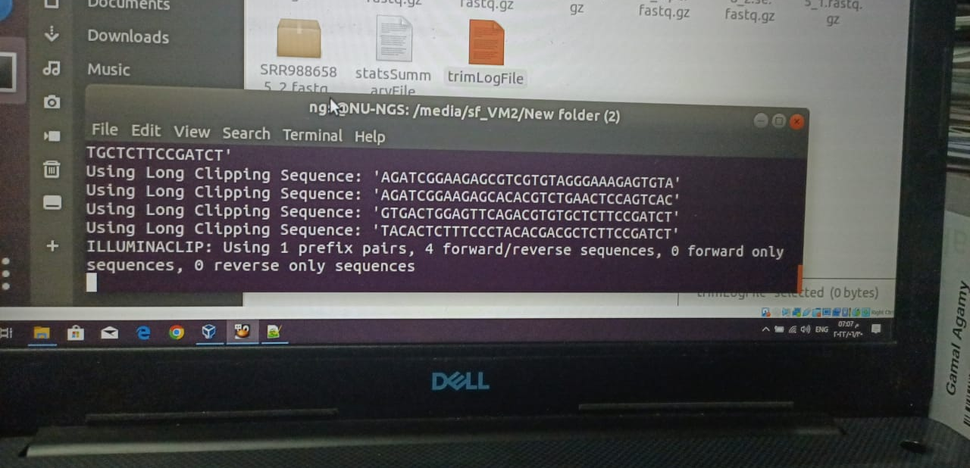
Trimming for forward and reverse files

Slide 29
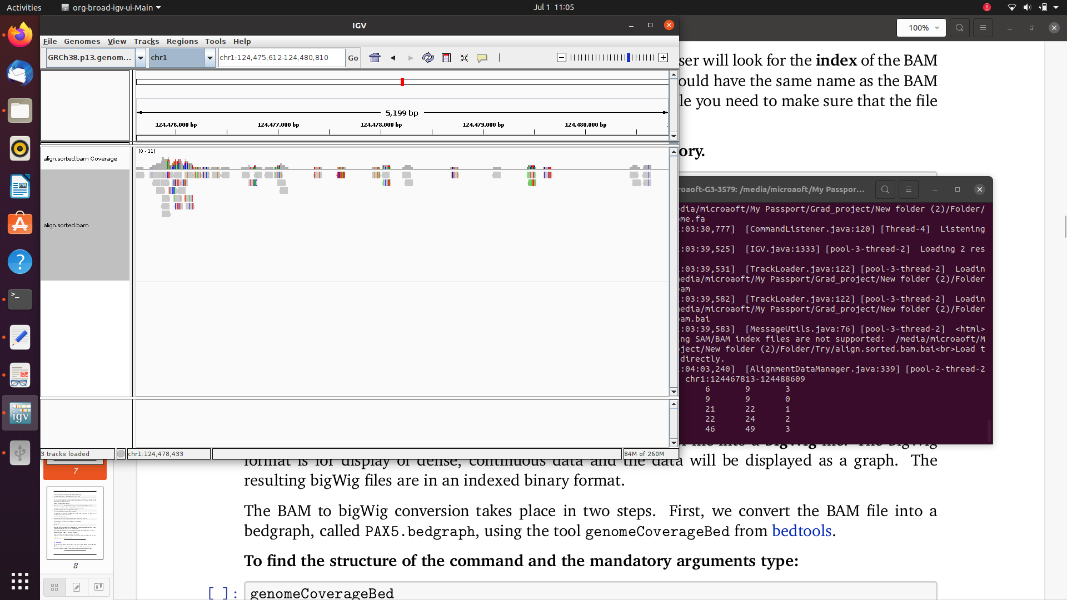
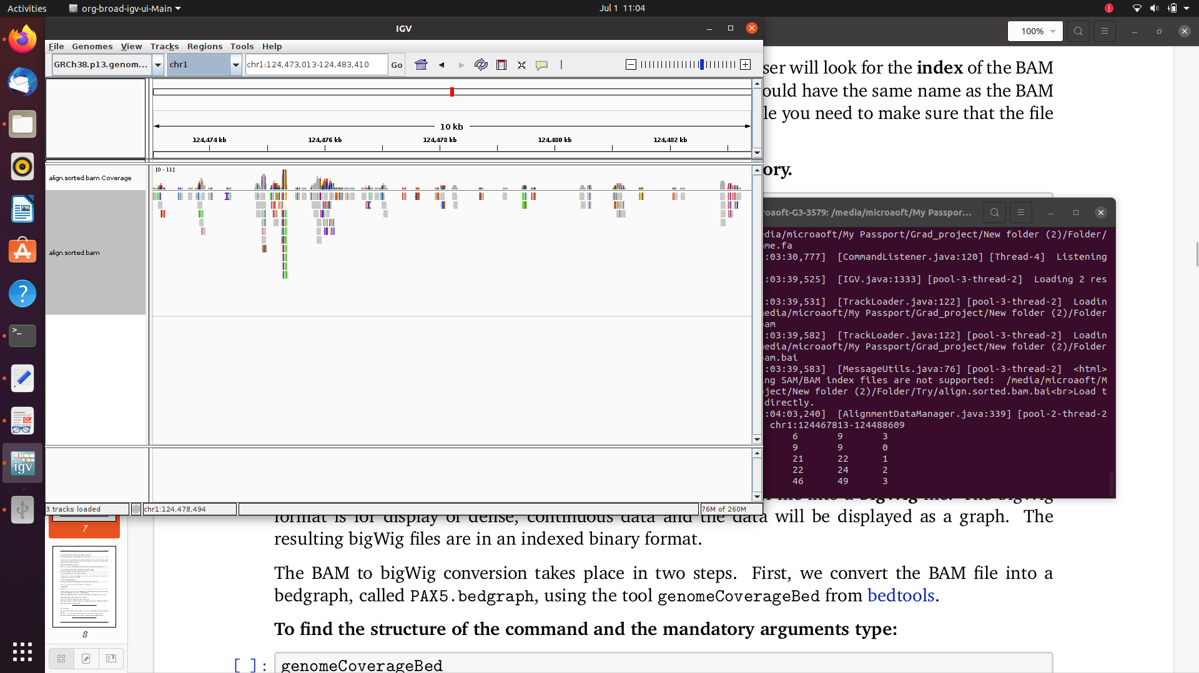
Calling Peaks using igv

Slide 30
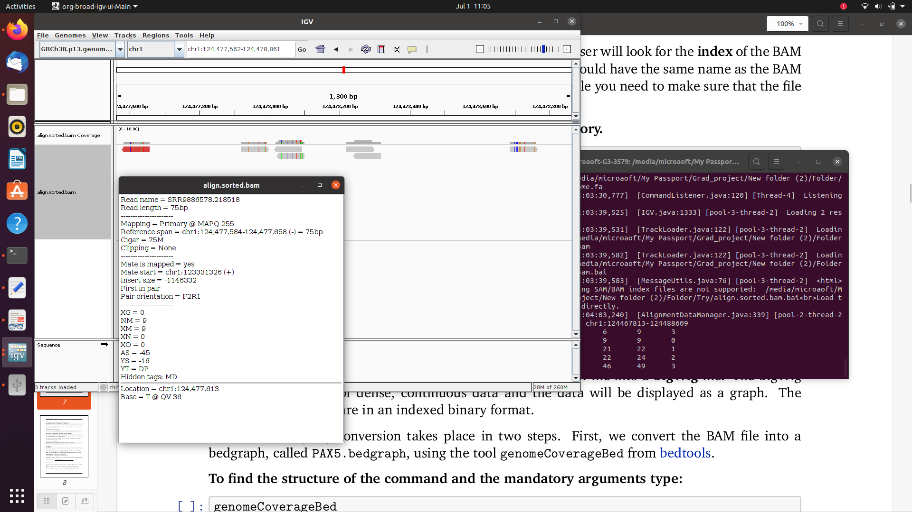
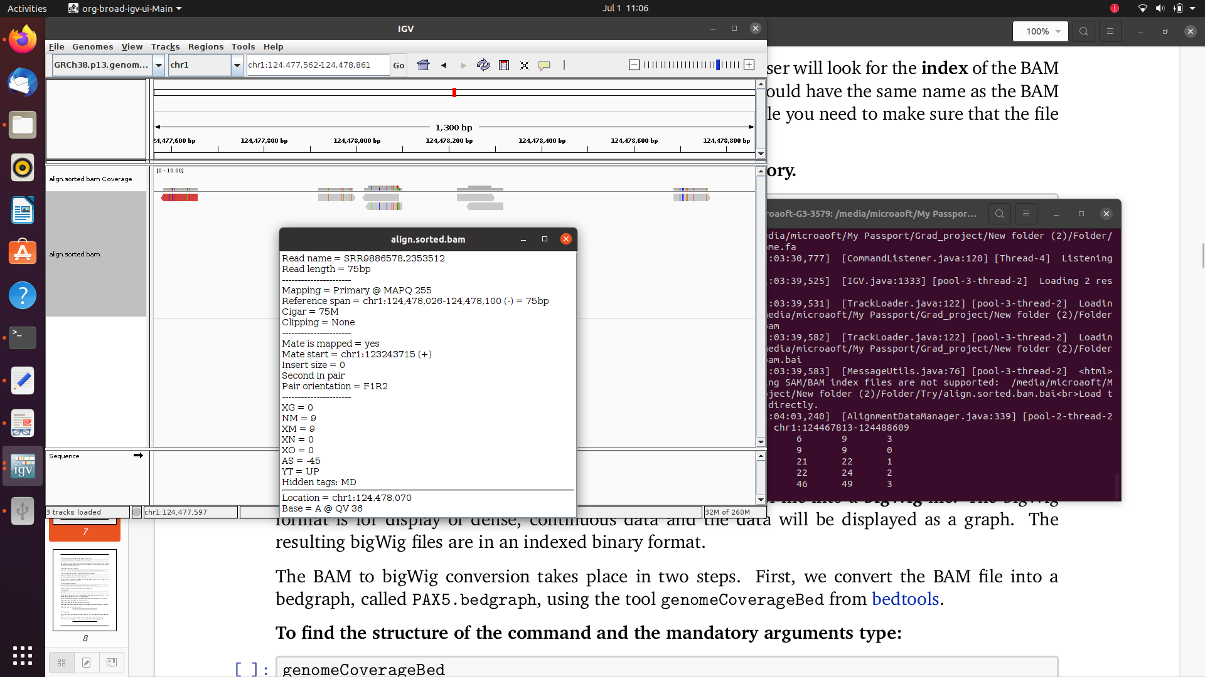
Meta data about some peaks

Slide 31
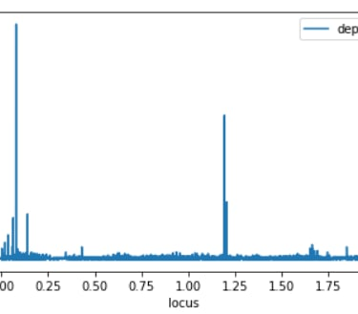
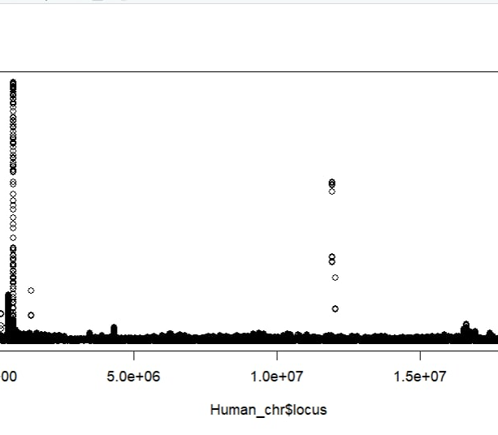
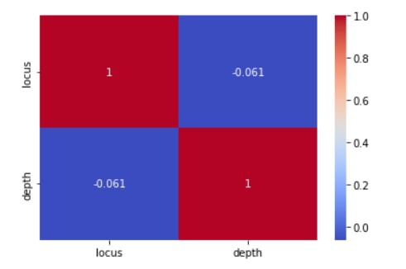
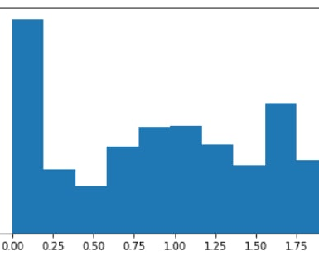
Visualization of distribution for BED file

Slide 32
Thank you

